Slide 1


Planning presentation
Fast and furious Game Playing : MonteCarlo drift
Students :
Prateek Bhatnagar Baptiste Bignon Mikaïl Demirdelen Gabriel Prevosto Dan Seeruttun--Marie Benoît Viguier
Supervisors :
Nikolaos Parlavantzas Christian Raymond
Year 2014-2015

Slide 2
Introduction
Create an Artificial Intelligence
Game not solved
Made to be difficult for computers
ARIMAA
MCTS Algorithm
Optimization by parallelization

Slide 3
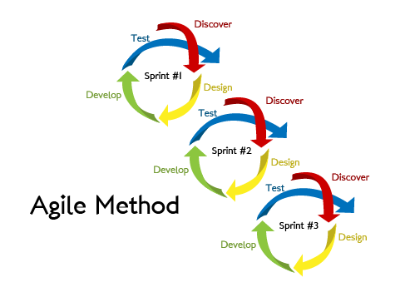
Agile Methodology:
Development Methodologies
Iterative software development methodology for building and testing the software incrementally.

Slide 4
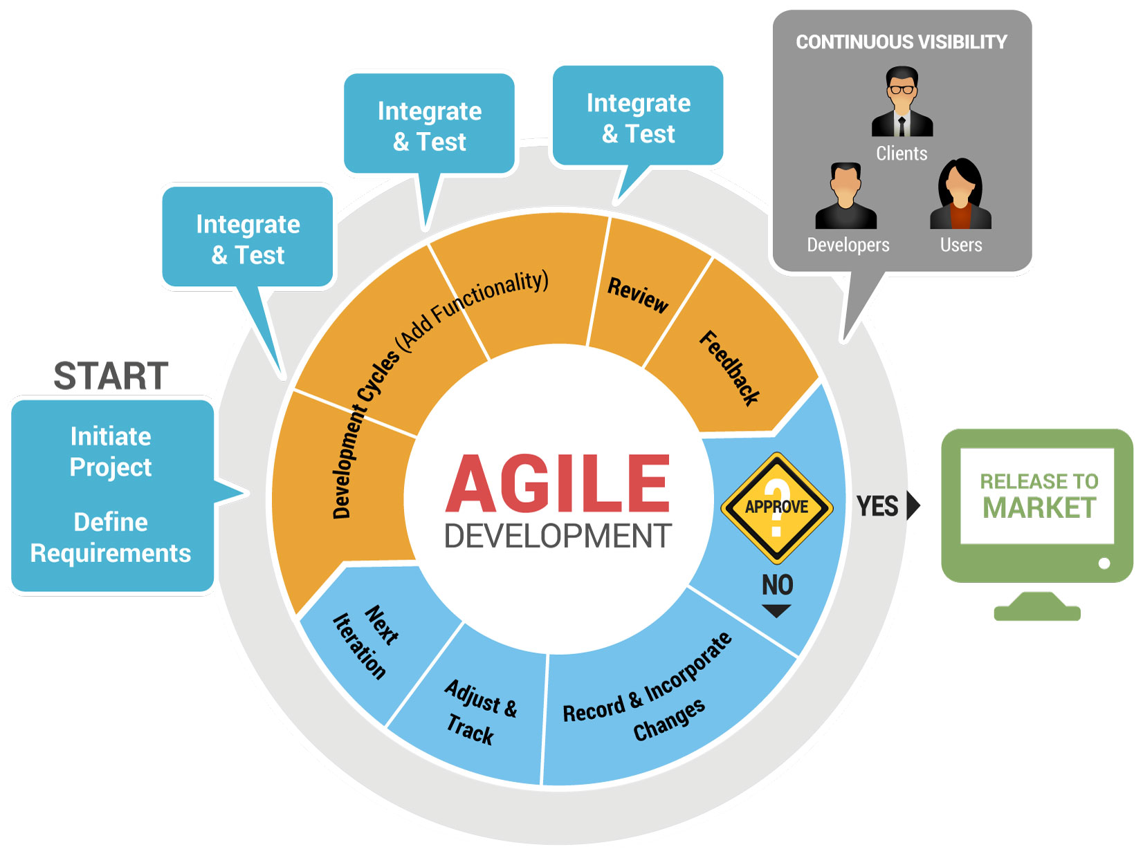
Key Areas :
Development Methodologies
Regular meetings
"To Do" list
Estimation of time and resources

Slide 5

Planning Poker Estimation Technique
Development Methodologies
Method for workloads
The method:
Guess workloads individually
No influence on the others
The treatment of solutions:
Eliminate singular guesses
Discuss together what will be the workload then
 | Gabriel | Prateek | Mikaïl | Baptiste | Benoît | Dan | Final Workload
MCTS general algorithm | 7,5 | 50 | 5 | 25 | 30 | 3 | 25

Slide 6
Development Methodologies
Key Areas :
Regular meetings
"To Do" list
Estimation of time and resources
Prioritization of tasks
Development using top to bottom approach
Feedback from the end user or the team
Iterations

Slide 7
Environment
Human resources:
Team of 6 until January
Team of 3 after January
Technological resources:
Computers from INSA's computer science department
Grid'5000, a set of clusters of multi-core machines

Slide 8
Risks analysis
Kinds of risk:
1) Resources
2) Organisation
3) Payments
4) Suppliers/Purchases
5) Technical
=> unavoidable
=> none
=> none
=> none

Slide 9
Risks analysis
Kinds of risk:
5) Technical
=> Unexpected bugs can occur during the development
=> interoperability problems (Grid'5000 = linux, we currently use Windows)
Solution : dedicate enough time to fix them.
Solution : regular tests at the computer science department

Slide 10
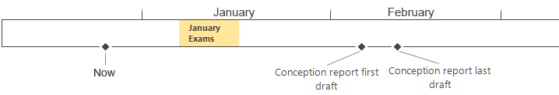
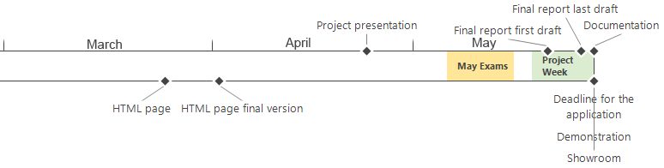
Important dates

Slide 11
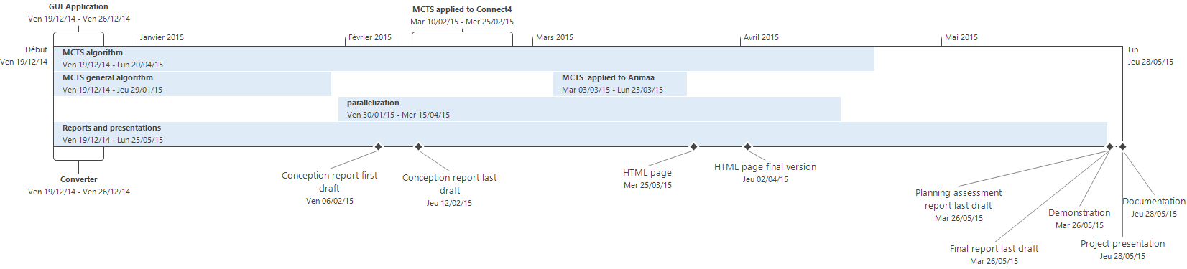
Tasks planning

Slide 12
Conclusion
Agile methodology along our project
Poker method to get a better estimation of the workload
Analysis of Environment
Internal and external resources
Dates
Risks
Schedule based on the aforementioned results

